Slide 1









KEMENTERIAN PENDIDIKAN TINGGI,
SAINS, DAN TEKNOLOGI
REPUBLIK INDONESIA
DECISION SUPPORT SYSTEM FOR RANKING BEST STUDENTS USING WEIGHTED PRODUCT AT SMK BINA INDUSTRI CIKARANG
By Rama Pramudya Wibisana
2022320019
SI22B

Slide 2

KEMENTERIAN PENDIDIKAN TINGGI,
SAINS, DAN TEKNOLOGI
REPUBLIK INDONESIA
Introduction
This research discusses the design and development of a web-based decision support system to assist the process of selecting the best student at SMK Bina Industri Cikarang. The system applies the Weighted Product method to produce a more objective, measurable, and efficient student ranking process.

Slide 3
KEMENTERIAN PENDIDIKAN TINGGI,
SAINS, DAN TEKNOLOGI
REPUBLIK INDONESIA
Background
The current process of selecting the best student at SMK Bina Industri Cikarang is still conducted through teacher deliberation. This process may lead to subjective judgments because there is no standardized quantitative calculation. In addition, assessment data such as academic scores, attitude scores, organizational activity, and internship scores are still managed separately, making the recapitulation process slower and more vulnerable to errors.

Slide 4
KEMENTERIAN PENDIDIKAN TINGGI,
SAINS, DAN TEKNOLOGI
REPUBLIK INDONESIA
Problem Statement
01.
The best student selection process is still subjective because it relies on teacher deliberation.
02.
Student assessment data is stored in separate documents, which slows down the data processing process.
03.
There is no system that automatically calculates criterion weights to generate accurate student rankings.

Slide 5
KEMENTERIAN PENDIDIKAN TINGGI,
SAINS, DAN TEKNOLOGI
REPUBLIK INDONESIA
Objectives
Objective 1
Objective 2
To design and develop a web-based decision support system for selecting the best student.
To implement the Weighted Product method in order to generate objective student rankings.
Objective 3
To evaluate the effectiveness of the system in accelerating the assessment administration process and providing recommendations to the school.

Slide 6
KEMENTERIAN PENDIDIKAN TINGGI,
SAINS, DAN TEKNOLOGI
REPUBLIK INDONESIA
Literature Review
A Decision Support System is a computer-based system designed to assist decision-makers in solving semi-structured problems. The Weighted Product method is used because it can evaluate alternatives based on multiple criteria by multiplying attribute values that have been powered by their respective criterion weights. The system development uses Next.js, TypeScript, and PostgreSQL as the main technologies.

Slide 7
KEMENTERIAN PENDIDIKAN TINGGI,
SAINS, DAN TEKNOLOGI
REPUBLIK INDONESIA
Methodology
The data collection techniques used in this research include observation, interviews, and literature study. Observation was conducted to understand the existing best student selection process. Interviews were carried out with school representatives to identify the required assessment criteria. Literature study was used to strengthen the theoretical foundation related to Decision Support Systems, the Weighted Product method, RAD, and web-based system development.

Slide 8
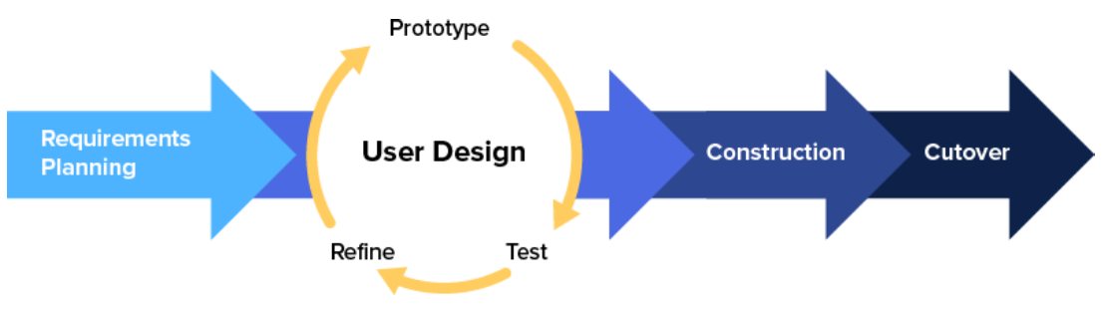
KEMENTERIAN PENDIDIKAN TINGGI,
SAINS, DAN TEKNOLOGI
REPUBLIK INDONESIA
System Development Model
Source: [Masaid et al., 2024]
This research uses the Rapid Application Development model. The stages include Requirements Planning, User Design, Construction, and Cutover. RAD was selected because it supports fast and iterative system development while involving users in the design refinement process.

Slide 9
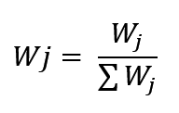
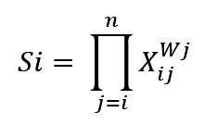
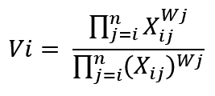
KEMENTERIAN PENDIDIKAN TINGGI,
SAINS, DAN TEKNOLOGI
REPUBLIK INDONESIA
Weighted Product
The Weighted Product method consists of several stages: determining assessment criteria, assigning score weights, determining criterion and sub-criterion weights, normalizing the weights, calculating the S vector, and calculating the V vector. The final result is a preference value used to rank students from the highest score to the lowest score.

Slide 10
KEMENTERIAN PENDIDIKAN TINGGI,
SAINS, DAN TEKNOLOGI
REPUBLIK INDONESIA
Research Framework
The research begins with the identification of problems in the current best student selection process. It continues with data collection, requirements planning, user design, system construction, and system implementation. The expected output is a web-based decision support system that produces objective, transparent, and efficient student rankings.

Slide 11
KEMENTERIAN PENDIDIKAN TINGGI,
SAINS, DAN TEKNOLOGI
REPUBLIK INDONESIA
THANK YOU

